Slide 1

Large Scale Analysis: Crimes in Chicago
By Harsh Vardhan Pachisia
May 2024

Slide 2
Project Overview
Goal: Analyze reported incidents of crime in the City of Chicago from 2001 to the present.
Why:
I’ve worked in crime prevention earlier and understand its social complexities and how it affects quality of life and economic development of communities.
Understanding crime patterns is crucial for law enforcement and community organizations to effectively combat and prevent crime.
Focus:
Identify trends of crime and make ML-based predictions based various socio-economic factors that may influence crime rates and evaluate the impact of external factors like the COVID-19 pandemic on criminal activities
Notes:
The goal of this project is to analyze reported incidents of crime in the City of Chicago from 2001 to the present, utilizing a comprehensive dataset that contains over 10 million rows and 22 columns. This data, sourced from the Chicago Police Department's CLEAR (Citizen Law Enforcement Analysis and Reporting) system, includes information such as incident type, location (at the block level), and date of occurrence. Through this project, I aim to understand crime patterns, trends, and correlations, which can help in effective resource allocation, policy-making, and enhancing community resilience.

Slide 3
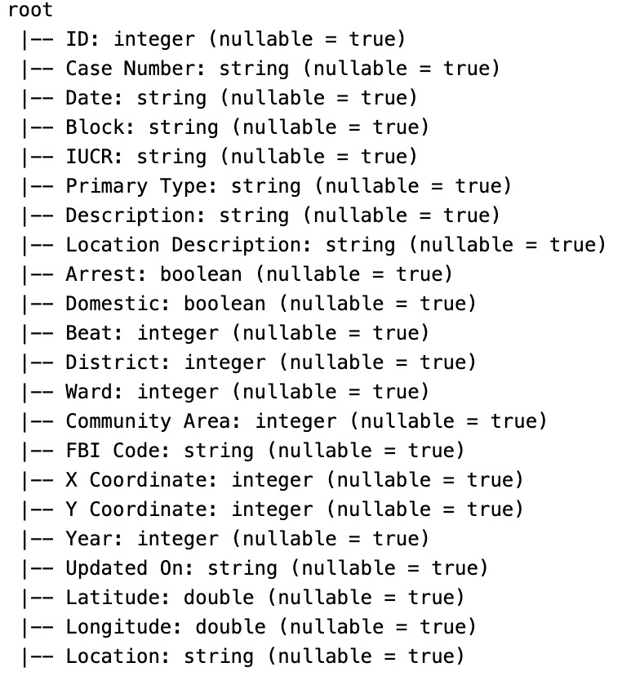
Datasets
1. Crimes: Comprehensive dataset of over 10 million rows and 22 columns (~2.5GB on S3).
2. Socio-economic indicators such as poverty and income levels
3. COVID-19 case data by community area
4. Community names
All data are sourced from the City of Chicago data portal
Notes:
utilizing a comprehensive dataset that contains over 10 million rows and 22 columns. This data, sourced from the Chicago Police Department's CLEAR (Citizen Law Enforcement Analysis and Reporting) system, includes information such as incident type, location (at the block level), and date of occurrence. Through this project, I aim to understand crime patterns, trends, and correlations, which can help in effective resource allocation, policy-making, and enhancing community resilience.

Slide 4
Why large-scale computing methods?
The volume, variety, and complexity of crime data necessitate the use of scalable computing methods.
In the past, when I’ve tried to work with the data, it was very slow to analyze with my computer, making it a good use case for large-scale computing.
Large-scale computing methods allow for the management and analysis of big data in a way that is both time-efficient and computationally feasible.
These methods enabled me to perform extensive data cleaning, integration, exploratory data analysis (EDA), and complex model training across the crimes dataset

Slide 5
Data integration and management
I created a python script to create an S3 bucket and upload the required datasets to it:
1. Crime data from the Chicago Police Department
2. Socio-economic indicators such as poverty and income levels
3. COVID-19 case data by community area
4. Community names
I also created a teardown script to use for deleting the bucket at the completion of the analysis.

Slide 6
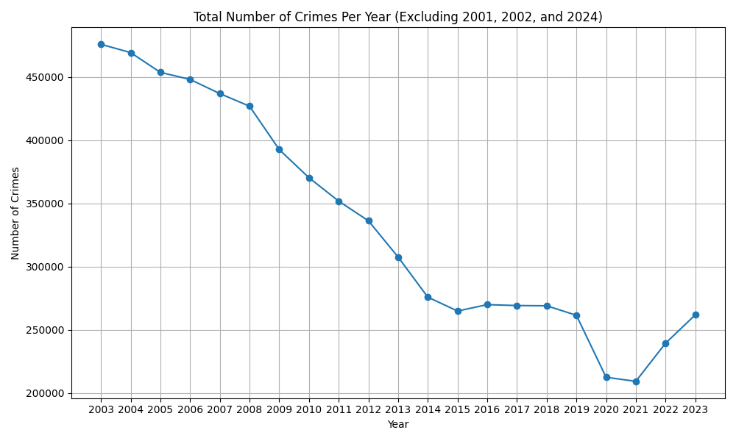
Exploratory Data Analysis (EDA)
Conducted extensive EDA using Pyspark
Major Findings:
1. The perception that crimes keep increasing is incorrect, with them generally going down over time

Slide 7
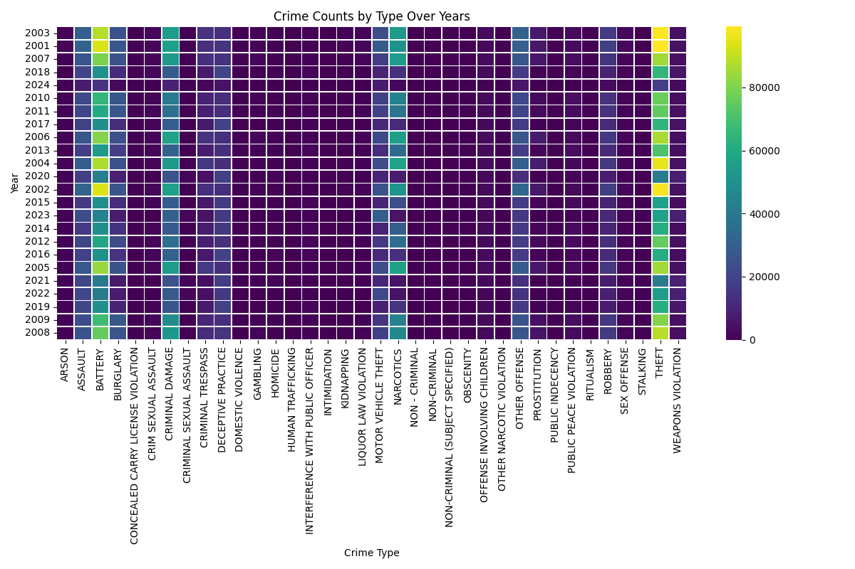
Exploratory Data Analysis (EDA)
Conducted extensive EDA using Pyspark
Major Findings:
2. Theft and battery are the most common crime types over time

Slide 8
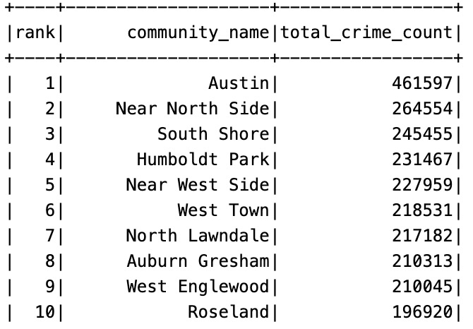
Exploratory Data Analysis (EDA)
Conducted extensive EDA using Pyspark
Major Findings:
3. Areas like Austin show higher crime rates, which prompts a deeper examination of regional disparities.

Slide 9
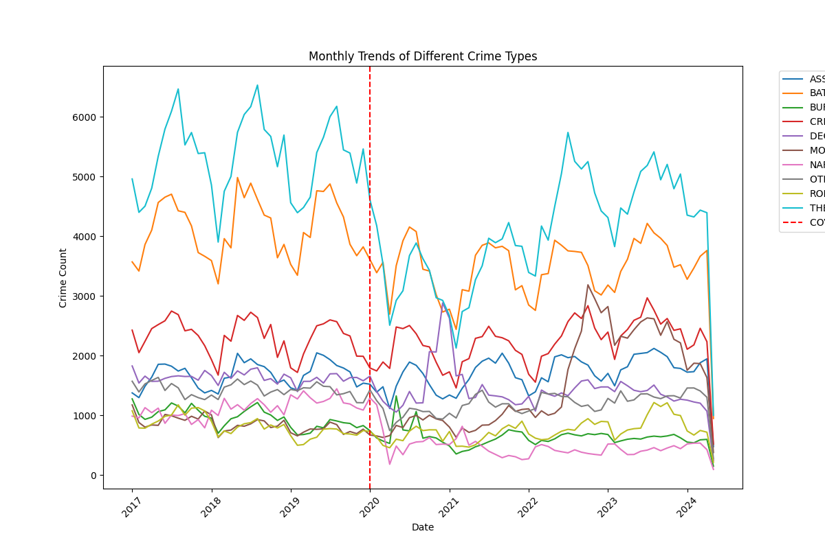
COVID-19 Impact Analysis
A sharp decline in overall crime rates during the early stages of the pandemic, likely due to lockdown measures and reduced public presence
Clear fall in 'Theft' as the largest crime type upon the onset of COVID-19 as people would be in lockdown.
Narcotics saw a rapid fall on the set of the pandemic due to the lockdown and don't seem to have recovered to pre-Covid levels.

Slide 10
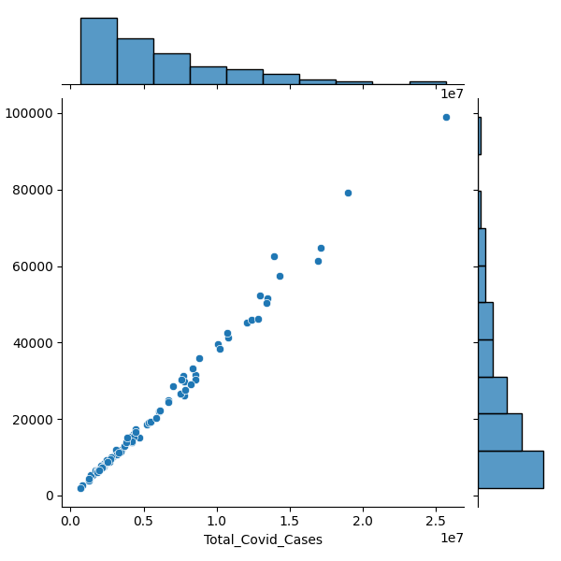
COVID-19 Impact Analysis
We see a very clear relationship between number of crimes and COVID cases in each neighborhood.
If number of crimes increases, the number of cases seem to increase as well.

Slide 11
Feature Engineering
I conducted extensive feature engineering on factors I thought could affect crime rates such as:
Month
Hour of day
Season
Yearly change in crime rate based on community
Duration since previous crime at the block level
Recurrence of crime
Etc.

Slide 12
ML 1 | Predicting primary type
Research Question: How can various environmental, temporal, and community-related factors be used to predict the primary type of crime in a given location, and what insights does this provide into the patterns of criminal activity in urban environments like Chicago?
Model Used: RandomForest Classifier
Metrics: 82% test accuracy. It also got weighted precision and recall of 82%, and an F1 score of 81%.
Significant features included the description of the crime and geographic location.

Slide 13
ML 2 | Predicting Arrests
Research Question: What factors predict the likelihood of an arrest during a crime?
Model Used: RandomForest Classifier
Metrics: This model predicted the likelihood of an arrest, achieving an accuracy of 87%.
Area under PR = 0.79
Area under ROC = 0.75
Highlighted the importance of the location and type of crime, along with socio-economic conditions.

Slide 14
ML 3 | Crime Rate Prediction
Research Question: Can socio-economic indicators and crime history predict the yearly crime rate change in a community?
Created target feature for yearly crime rate change in each community
Model Used: Linear Regression
Metrics: RMSE of 18.83, suggests moderate accuracy in its predictions.
below_poverty_level is -0.12, indicating a negative relationship, whereas per_capita_income has a positive coefficient of 0.72, suggesting a positive association with crime rate changes.
Low accuracy indicates the need for more comprehensive data to improve predictions.

Slide 15
Final Thoughts
Overall, the project showcases the power and effectiveness of using PySpark and S3 for large scale data analysis
I’m interested in continuing this work forward in future research projects

